Slide 1
Splash Screen

Slide 2
Lesson Menu
Five-Minute Check (over Lesson 6–7)
Then/Now
New Vocabulary
Example 1: Dilation in a Coordinate Plane
Example 2: Standardized Test Example
Concept Summary: Scale Factor
Example 3: Find a Scale Factor

Slide 3
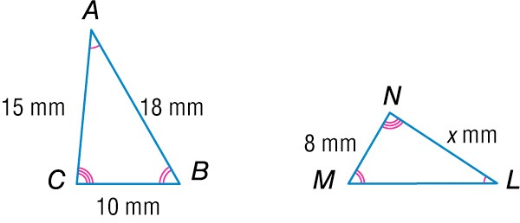
5-Minute Check 1
The figures are similar. Find the missing measure.
A. 17 mm
B. 13 mm
C. 12 mm
D. 11 mm

Slide 4
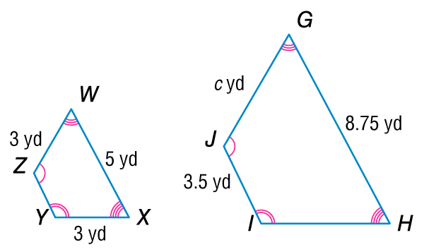
5-Minute Check 2
The figures are similar. Find the missing measure.
A. 6.75 yd
B. 5.25 yd
C. 5 yd
D. 3.75 yd

Slide 5
5-Minute Check 3
A triangular pendant has a height of 6 inches and a base length of 15 inches. A similar striped pendant has a base length of 20 inches. What is the height of the striped pendant?
A. 8 in.
B. 6 in.
C. 4 in.
D. 2 in.

Slide 6
5-Minute Check 4
A. B.
C. 5 meters D.

Slide 7
5-Minute Check 5
Trapezoid MNOP is similar to trapezoid STUV. Which of the following statements is true?
A. MN ~ ST
B. PM ~ TU
C. SV ~ TV
D. OP ~ NM

Slide 8
Then/Now
You have already used transformations such as translations and reflections in the coordinate plane. (Lesson 2–7)
Graph dilations on a coordinate plane.
Find the scale factor of a dilation.

Slide 9
Vocabulary
dilation

Slide 10
Example 1
Dilation on the Coordinate Plane
A figure has vertices D(–4, 4), E(4, 8), F(8, 8), and G(4, 0). Graph the figure and the image of the polygon after a dilation with a scale factor of .

Slide 11
Example 1
Dilation on the Coordinate Plane

Slide 12
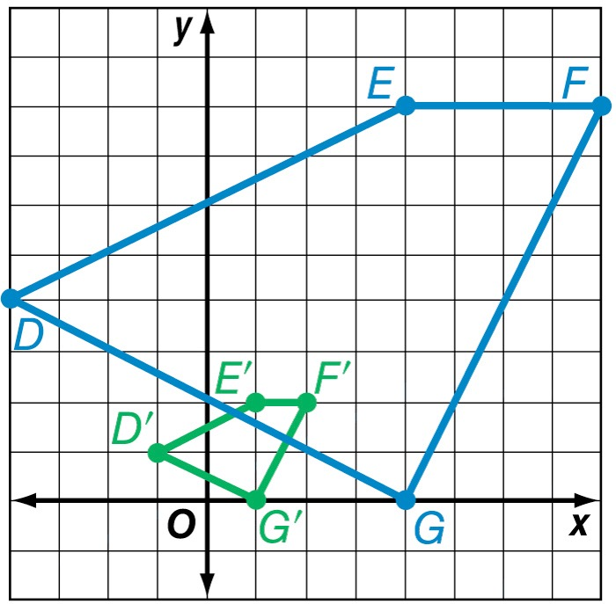
Example 1
Dilation on the Coordinate Plane
Answer:

Slide 13
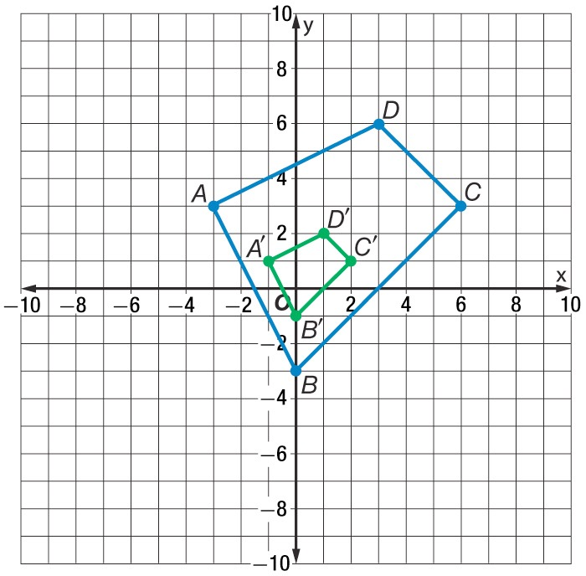
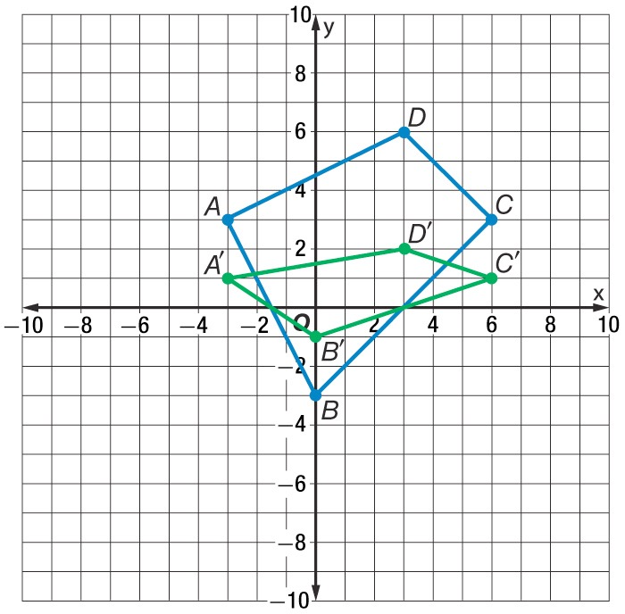
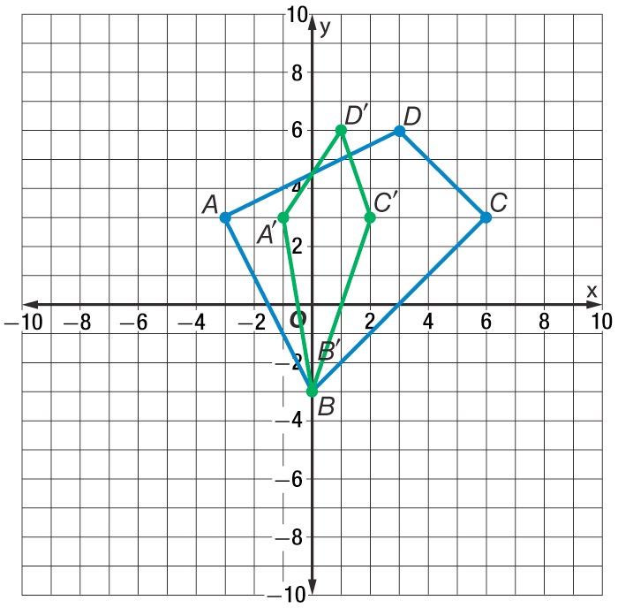
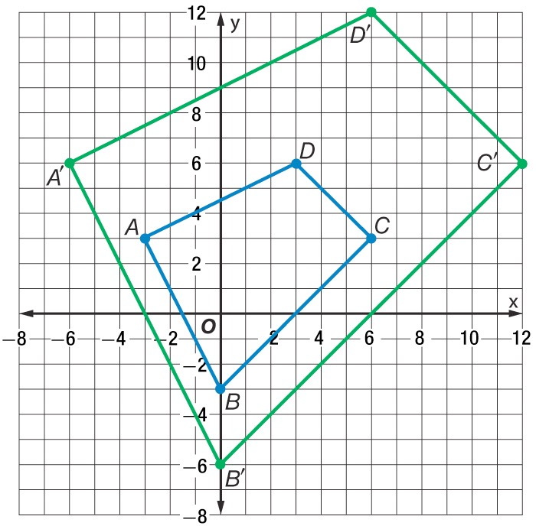
Example 1
A figure has vertices A(–3, 3), B(0, –3), C(6, 3), D(3, 6) and is dilated by a scale factor of . Which figure shows the correct figure and image?
A. B.
C. D.

Slide 14
Example 2
A triangle has vertices H(–1, –2), I(1, 4), and J(2, 1). Find the coordinates of the triangle after a dilation with a scale factor of 4.
A H'(4, 8), I'(–4, –16), J'(–8, –4)
B H'(–4, –8), I'(4, 16), J'(8, 4)
C H' , I' , 1 , J'
D H'(–4, –8), I'(4, 8), J'(8, –4)

Slide 15
Example 2
Read the Test Item
You are asked to find the coordinates of the image after the dilation. Multiply the coordinates of each vertex by the scale factor.
Solve the Test Item
The dilation is (x, y) → (4x, 4y).
H(–1, –2) → (4 ● –1, 4 ● –2) → H'(–4, –8)
I(1, 4) → (4 ● 1, 4 ● 4) → I'(4, 16)
J(2, 1) → (4 ● 2, 4 ● 1) → J'(8, 4)
Answer: The answer is B.

Slide 16
Example 2
A triangle has vertices A(1, –2), B(–2, 3), and C(1, 1). Which are the coordinates of the triangle after a dilation with scale factor of 5?
A. A' (6, 3), B' (3, 8), C' (6, 6)
B. A' (5, –10), B' (–10, 15), C' (5, 5)
C. A' (–10, 5), B' (15, –10), C' (5, 5)
D. A' (–4, 7), B' (–7, 2), C' (–4, 4)

Slide 17
Concept

Slide 18
Example 3
Find a Scale Factor
COPIES Peri is enlarging a page from a book on the copy machine. The original page measured 14 centimeters by 21 centimeters. If the enlarged image measures 17.5 centimeters by 26.25 centimeters, what is the scale factor of the dilation?
Write a ratio comparing the lengths of the two pages.

Slide 19
Example 3
Find a Scale Factor

Slide 20
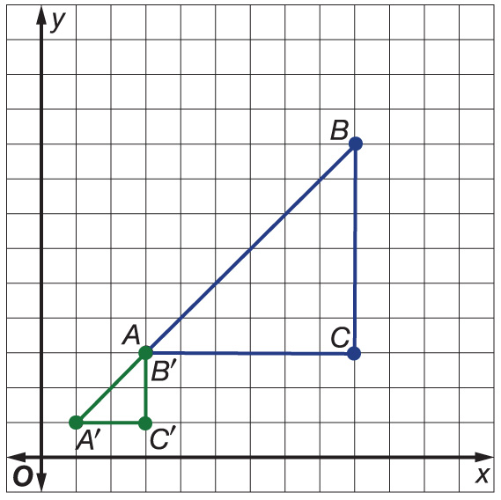
Example 3
Triangle ABC has been reduced in size as shown on the graph. What is the scale factor of the dilation?
A.
B.
C. 2
D. 3

Slide 21
End of the Lesson

